Slide 1
TIME ACCOUNTING APPLICATION
A new WEB based APP from the FIDO Sub Committee
Utilizes the credentials for access to FIDO
Works with Apple or Android devices
Also works on tablets, laptops, desk top and other WEB accessible Devices
Posting project times by the Team Leader or Assistant

Slide 2
How do you get to the APP?
On your device, enter the following into your browser or search window:
https://fctsfido.org/hours/
If you are having problems reaching the APP try changing your browser
We recommend Firefox or Chrome

Slide 3
The APP opens to the log-in screen – Remember to use your FIDO credential’s

Slide 4
Enter your user name and password – click log-in

Slide 5
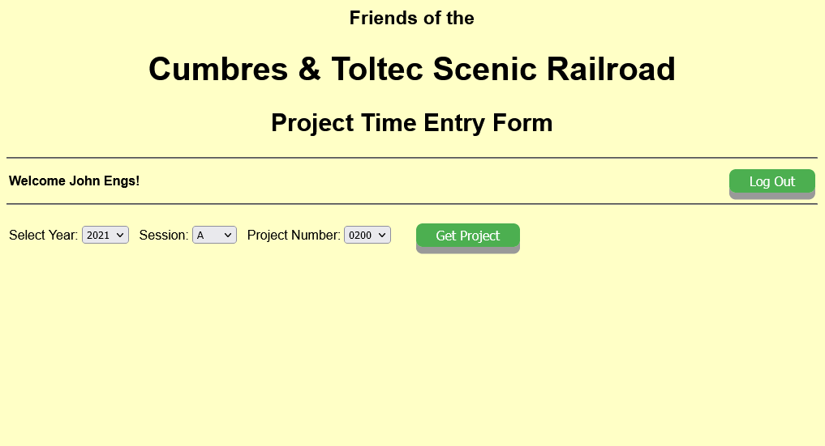
When log-in is accepted this screen appears – the select year is defaulted to the current posting year. Next use the pull-down menu to select the correct scheduled session or special session; do the same for the project number and click on get project. You are only allowed to post to projects you are listed as a Team Leader or Alternate for.

Slide 6
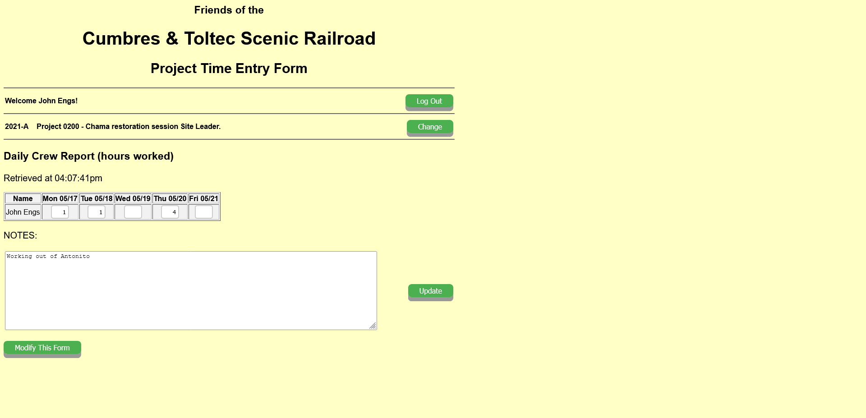
When ‘get project’ is entered the above screen appears. This is the posting screen. It lists team members in the left column followed by the days of the session. Entry of hours worked is made daily in the block provided. A text section for short notes is provided. These notes are not recorded anywhere other than on the time sheet.

Slide 7
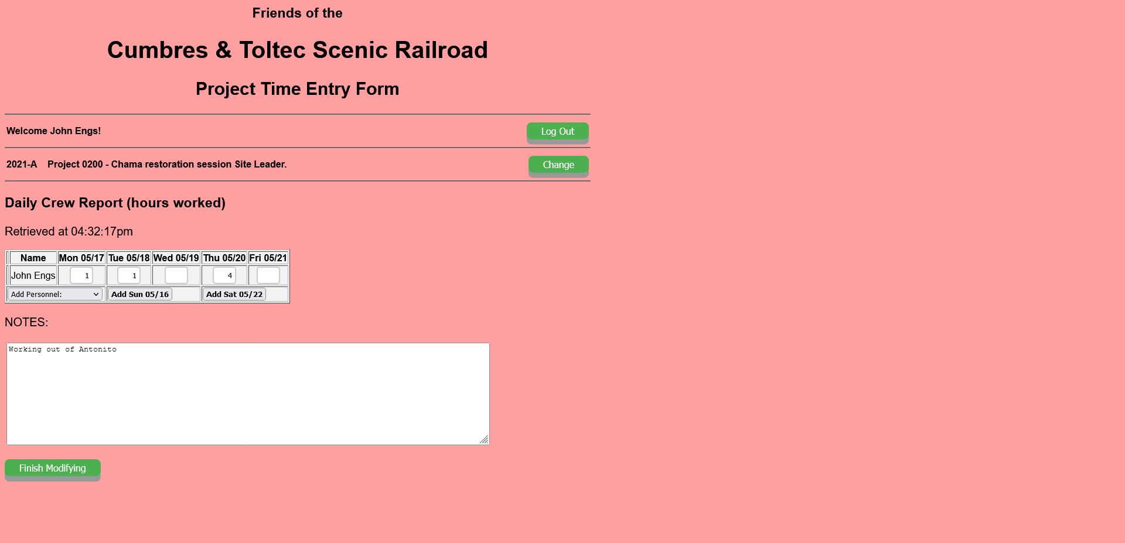
When “Modify This Form” is entered the screen turns pink to indicate you are making assignment changes to team members, adding others; or adding days at the beginning or end of the session. The modify mode also allows additional members to be deleted or days removed. While in this mode no posting of hours is permitted. When form adjustments are complete, click on finish modifying.

Slide 8
This is an example of a time posting where no schedule utilized. Each entry requires that the day of posting be entered. Even though there is no schedule for work the individual team members must be assigned to the project.

Slide 9
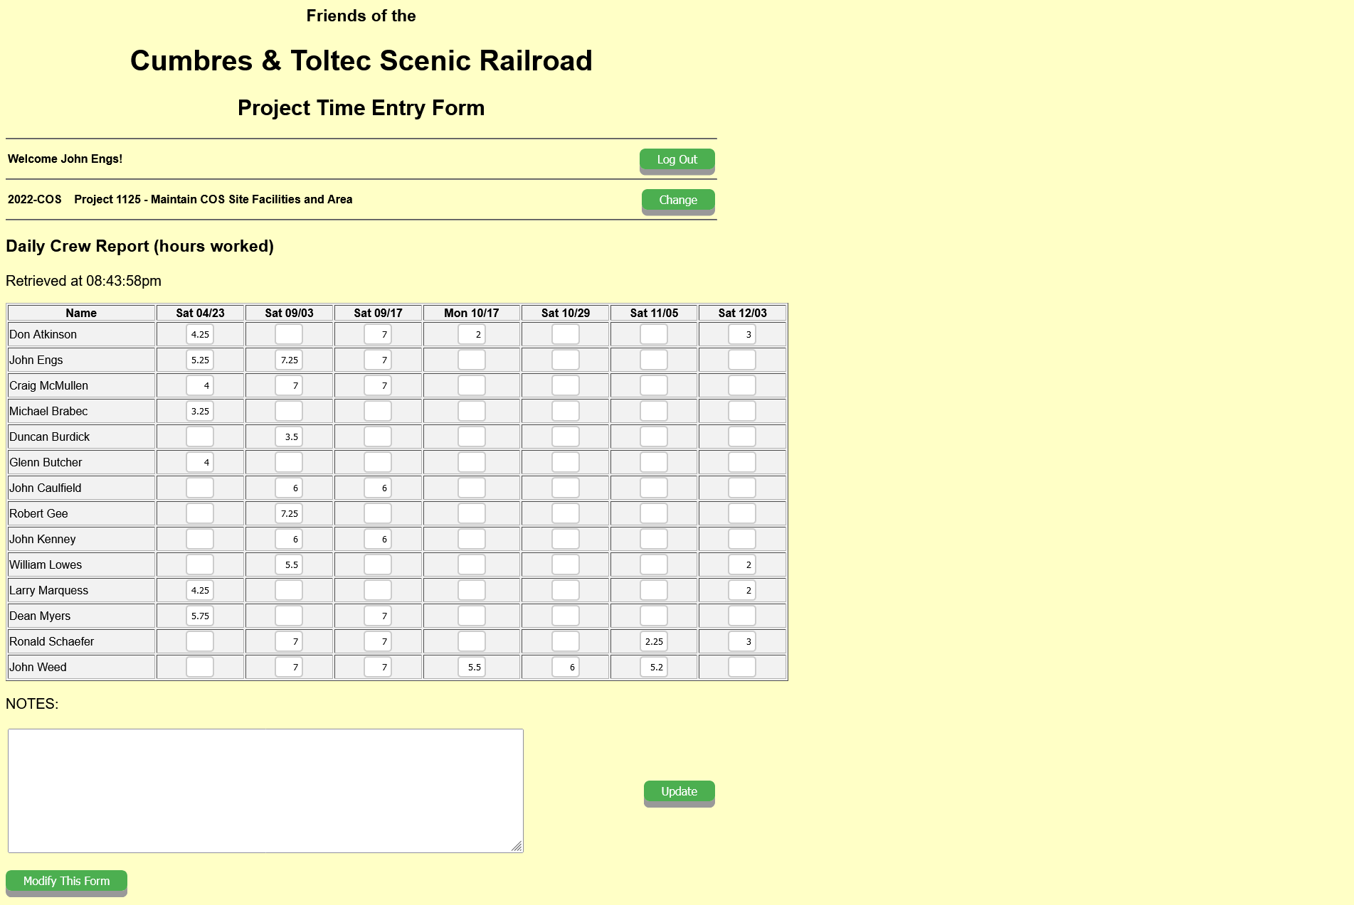
This shows the posting for only the days that work was accomplished and only by those working that day. The date of work is entered in the “Modify This Form” element. Entry of time can only be done from this screen with a background in yellow.

Slide 10
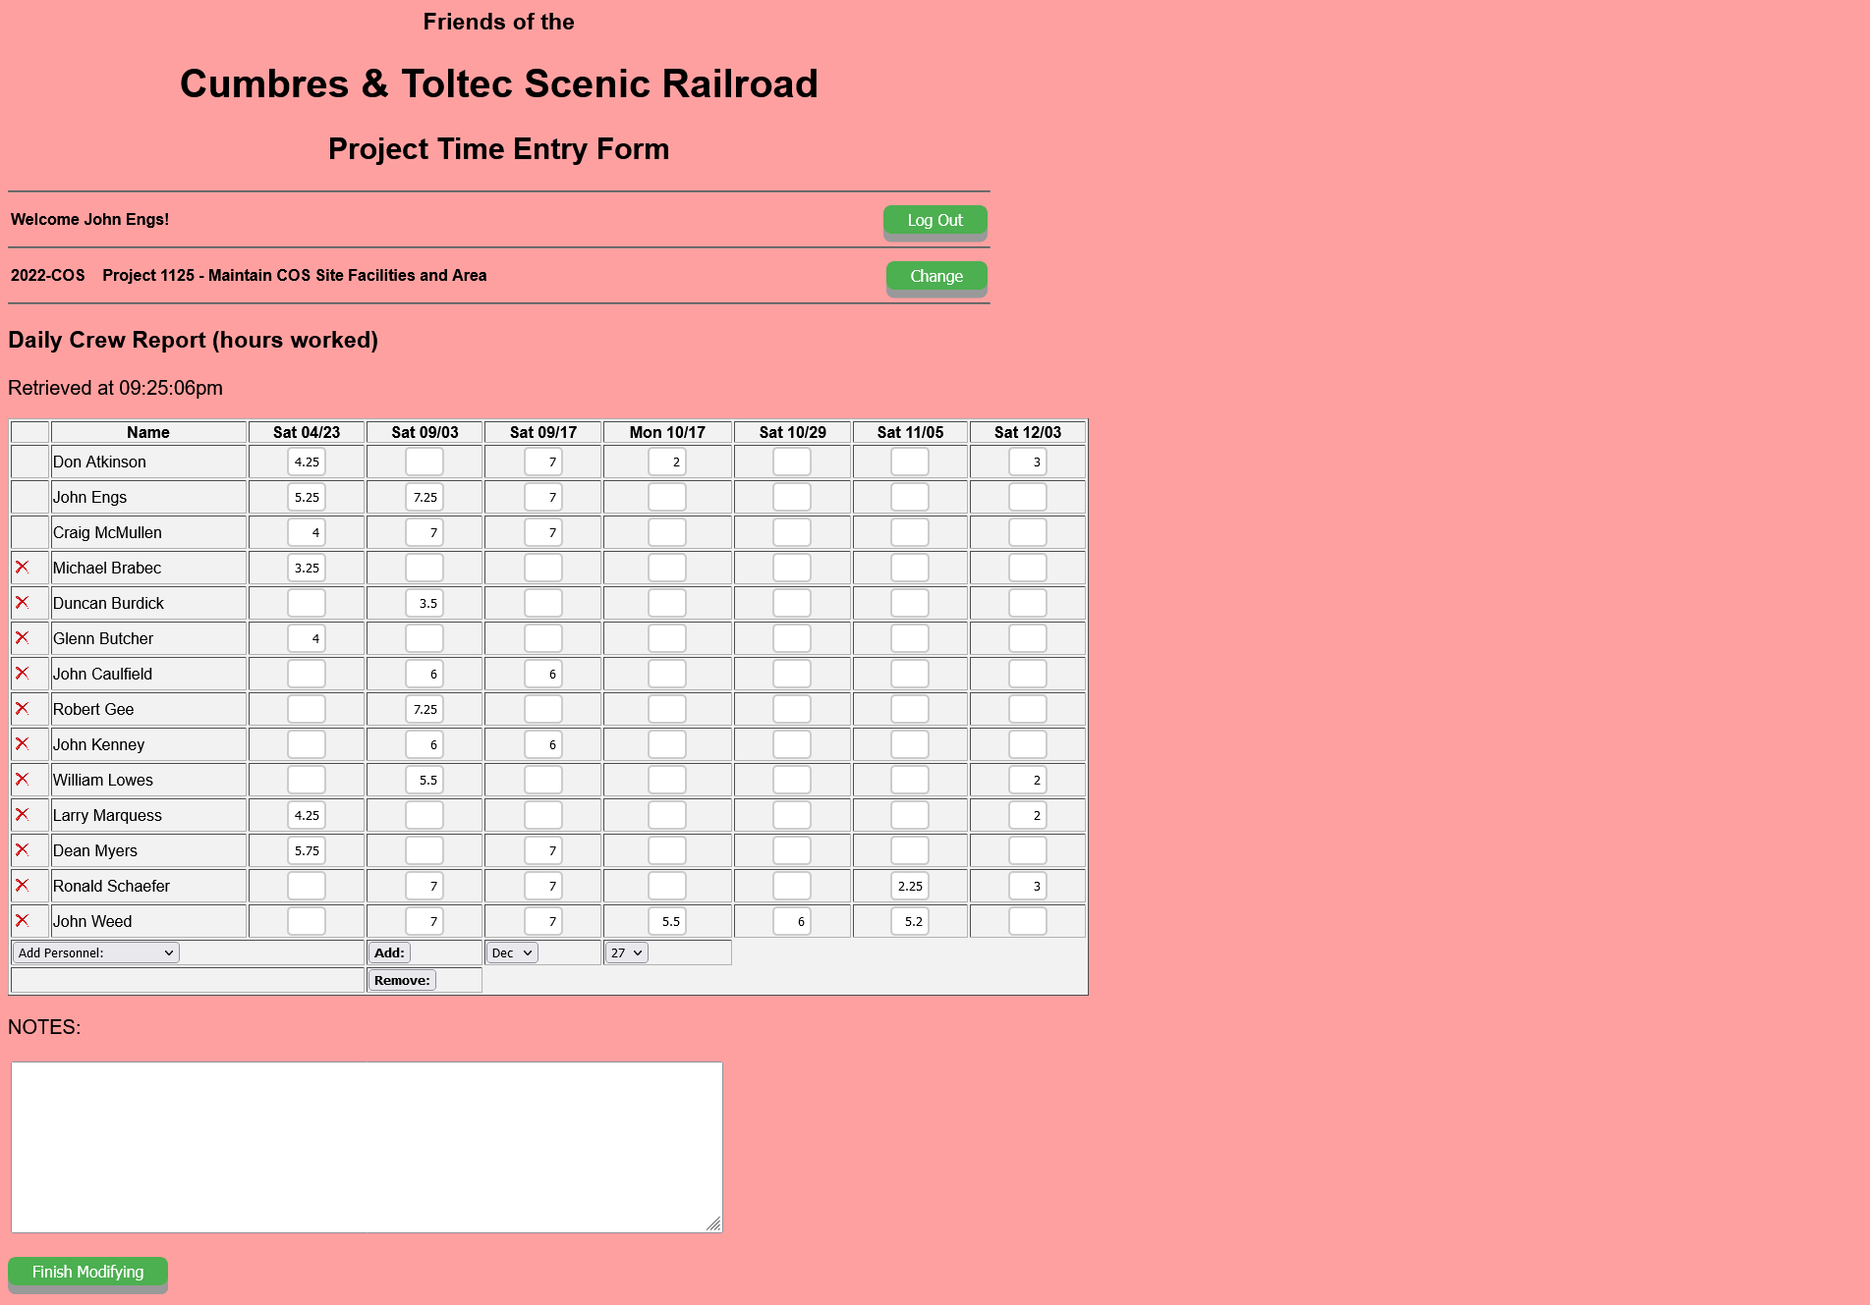
At the bottom of the posting screen on the left side you can add or remove personnel to the right of that you can add or remove work days. When finished with the changes click on “Finish Modifying”. The red “X” indicates an added member to the project.

Slide 11
Let’s demonstrate the APP’s functional versatility:
https://fctsfido.org/hours/

Slide 12
What are the results from time entries?
Entering this URL will display posting of time by year, project, session or individual.
https://fctsfido.org/hoursAcct

Slide 13
When a need arises to look at specific project and/or session, individual time sheets are available
https://fctsfido.org/timeSheets

Slide 14
https://fctsfido.org/hours/
As a Team Leader or Alternate look up your project for the current year. Make sure you have access to record the project time and keep track of who has registered for the project.
Credentials: email address Password: FIDO password
Year: Session: Project:

